Slide 1
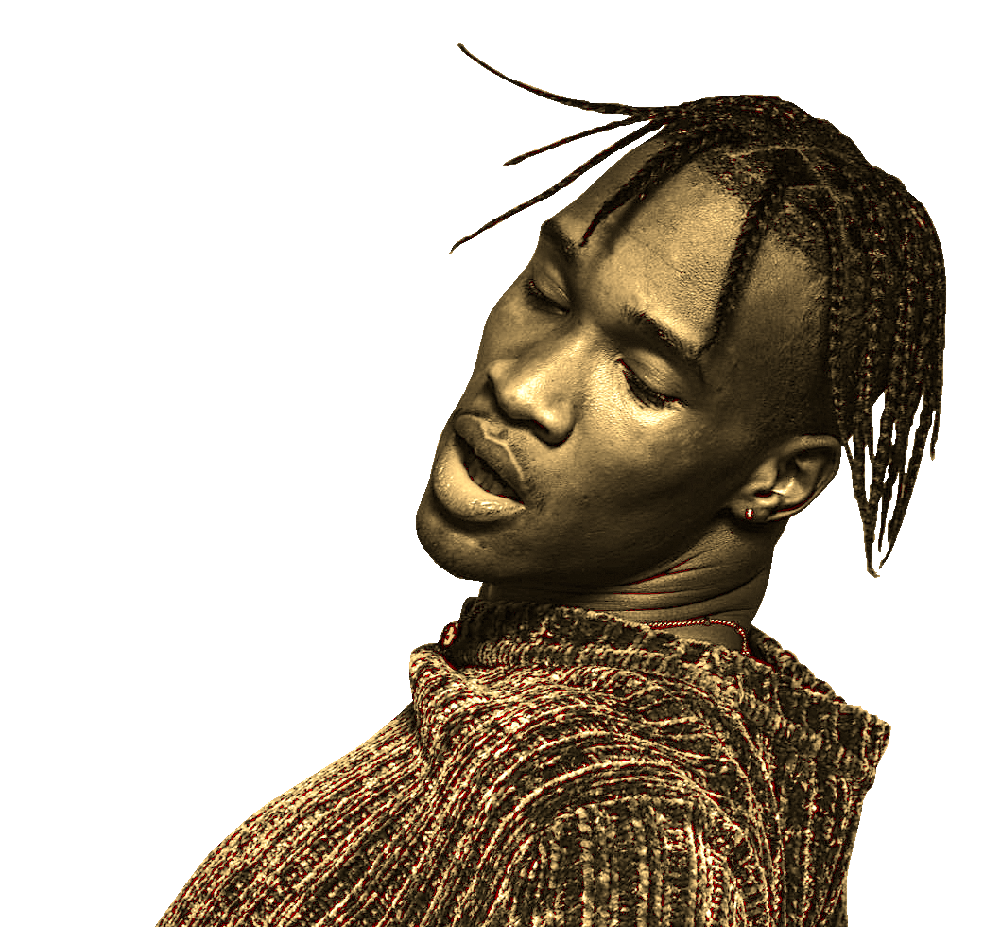

Insights
Analyzing "Most Streamed Spotify Songs 2023" Dataset
By Finley Black
& Exploration

Slide 2

Project Goals
Assess key metrics which May influence song popularity
Exploratory analysis
Does the danceability of a song impact the number of streams it receives?
Does the Liveness of a song impact streams?

Slide 3
Hypotheses
Null Hypothesis 1 (h0): There is no difference in streams between songs with a danceability of over 75% or under 75%.
Alternative Hypothesis 1 (ha): There is a significant (>0.05%) difference in streams between songs with a danceability of over 75% and under 75%. ________________________________________________
Null Hypothesis 2 (h0): There is no difference in streams between songs with a liveness score of under 25% or over 25%.
Alternative Hypothesis 2 (ha): There is significant (>0.05%) difference in streams between songs with a liveness score of under 25% or over 25%.

Slide 4
Process
Run exploratory analysis of the data set in python.
Run statistical analysis on the variables “liveness”, “danceability”, and “streams”.
Generate informational graphics on the results.

Slide 5
Exploratory Analysis
artist_count | released_year | released_month | released_day | in_spotify_playlists | in_spotify_charts | streams | in_apple_playlists | in_apple_charts | in_deezer_charts | bpm | danceability_% | valence_% | energy_% | acousticness_% | instrumentalness_% | liveness_% | speechiness_%
count | 953.000000 | 953.000000 | 953.000000 | 953.000000 | 953.000000 | 953.000000 | 9.520000e+02 | 953.000000 | 953.000000 | 953.000000 | 953.000000 | 953.00000 | 953.000000 | 953.000000 | 953.000000 | 953.000000 | 953.000000 | 953.000000
mean | 1.556139 | 2018.238195 | 6.033578 | 13.930745 | 5200.124869 | 12.009444 | 5.141374e+08 | 67.812172 | 51.908709 | 2.666317 | 122.540399 | 66.96957 | 51.431270 | 64.279119 | 27.057712 | 1.581322 | 18.213012 | 10.131165
std | 0.893044 | 11.116218 | 3.566435 | 9.201949 | 7897.608990 | 19.575992 | 5.668569e+08 | 86.441493 | 50.630241 | 6.035599 | 28.057802 | 14.63061 | 23.480632 | 16.550526 | 25.996077 | 8.409800 | 13.711223 | 9.912888
min | 1.000000 | 1930.000000 | 1.000000 | 1.000000 | 31.000000 | 0.000000 | 2.762000e+03 | 0.000000 | 0.000000 | 0.000000 | 65.000000 | 23.00000 | 4.000000 | 9.000000 | 0.000000 | 0.000000 | 3.000000 | 2.000000
25% | 1.000000 | 2020.000000 | 3.000000 | 6.000000 | 875.000000 | 0.000000 | 1.416362e+08 | 13.000000 | 7.000000 | 0.000000 | 100.000000 | 57.00000 | 32.000000 | 53.000000 | 6.000000 | 0.000000 | 10.000000 | 4.000000
50% | 1.000000 | 2022.000000 | 6.000000 | 13.000000 | 2224.000000 | 3.000000 | 2.905309e+08 | 34.000000 | 38.000000 | 0.000000 | 121.000000 | 69.00000 | 51.000000 | 66.000000 | 18.000000 | 0.000000 | 12.000000 | 6.000000
75% | 2.000000 | 2022.000000 | 9.000000 | 22.000000 | 5542.000000 | 16.000000 | 6.738690e+08 | 88.000000 | 87.000000 | 2.000000 | 140.000000 | 78.00000 | 70.000000 | 77.000000 | 43.000000 | 0.000000 | 24.000000 | 11.000000
max | 8.000000 | 2023.000000 | 12.000000 | 31.000000 | 52898.000000 | 147.000000 | 3.703895e+09 | 672.000000 | 275.000000 | 58.000000 | 206.000000 | 96.00000 | 97.000000 | 97.000000 | 97.000000 | 91.000000 | 97.000000 | 64.000000
 | Streams | Danceability | Liveness
Count | 9.520000e+02 | 953 | 953
Mean | 5.14137e+08 | 66.97% | 18.21%
STD | 5.668569e+08 | 14.63% | 13.71%
Min | 2.762000e+03 | 23% | 3%
Max | 3.703895+09 | 96% | 97%

Slide 6
Danceability visuals
T-statistic: -1.6693779295899012
P-value: 0.09537196499037393
With a p-value of 0.09, we can fail to reject the null hypothesis for danceability and see that there is no significant difference between the two groups.

Slide 7
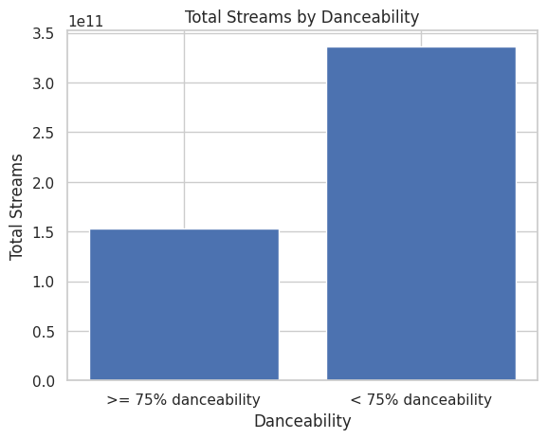
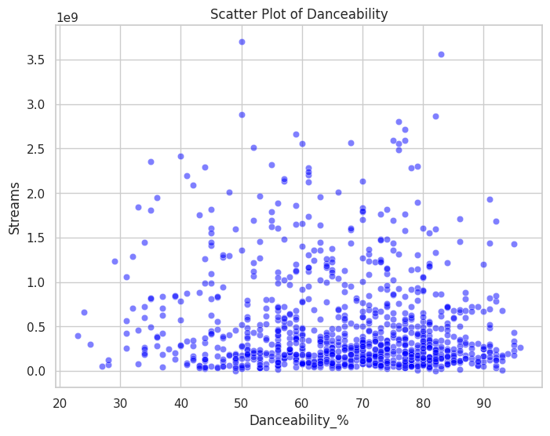
Bar chart and scatterplot

Slide 8
Analysis of liveness
T-statistic: -0.8303017775781691 P-value: 0.4065767882060246
Based on the P value above, we cannot reject the null hypothesis and conclude that there is not a significant difference songs with over 25% liveness and the number of streams vs songs with under 25% liveness.

Slide 9
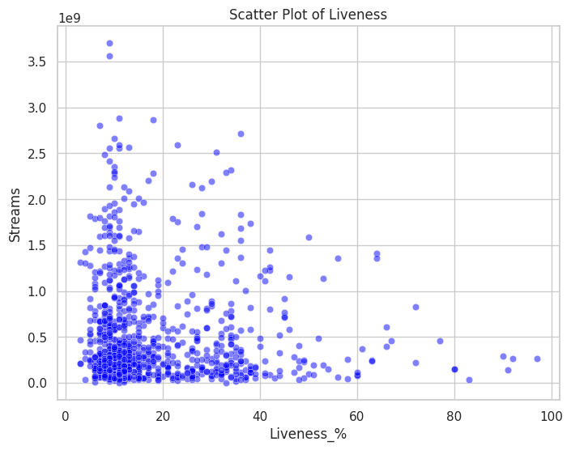
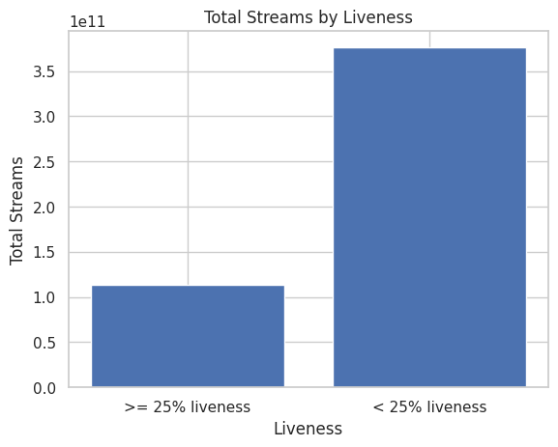
Liveness visuals

Slide 10
Final Message
Songs that are more danceable or have a lower quality of liveness do not necessarily have a statistically higher number of streams.
When record labels are choosing musicians to sign, these factors may be irrelevant.
To identify other factors that significantly impact the number of streams, further analysis should be conducted.
Music is a complex social art form, and many factors will influence its popularity, not only from within the music itself but also from external societal influences.
In future research, perhaps external influences could also be analyzed.
And recommendations

Slide 11
Contact
Finley Black
Finley.a.black@gmail.com
Data analysis
Data set

